Slide 1
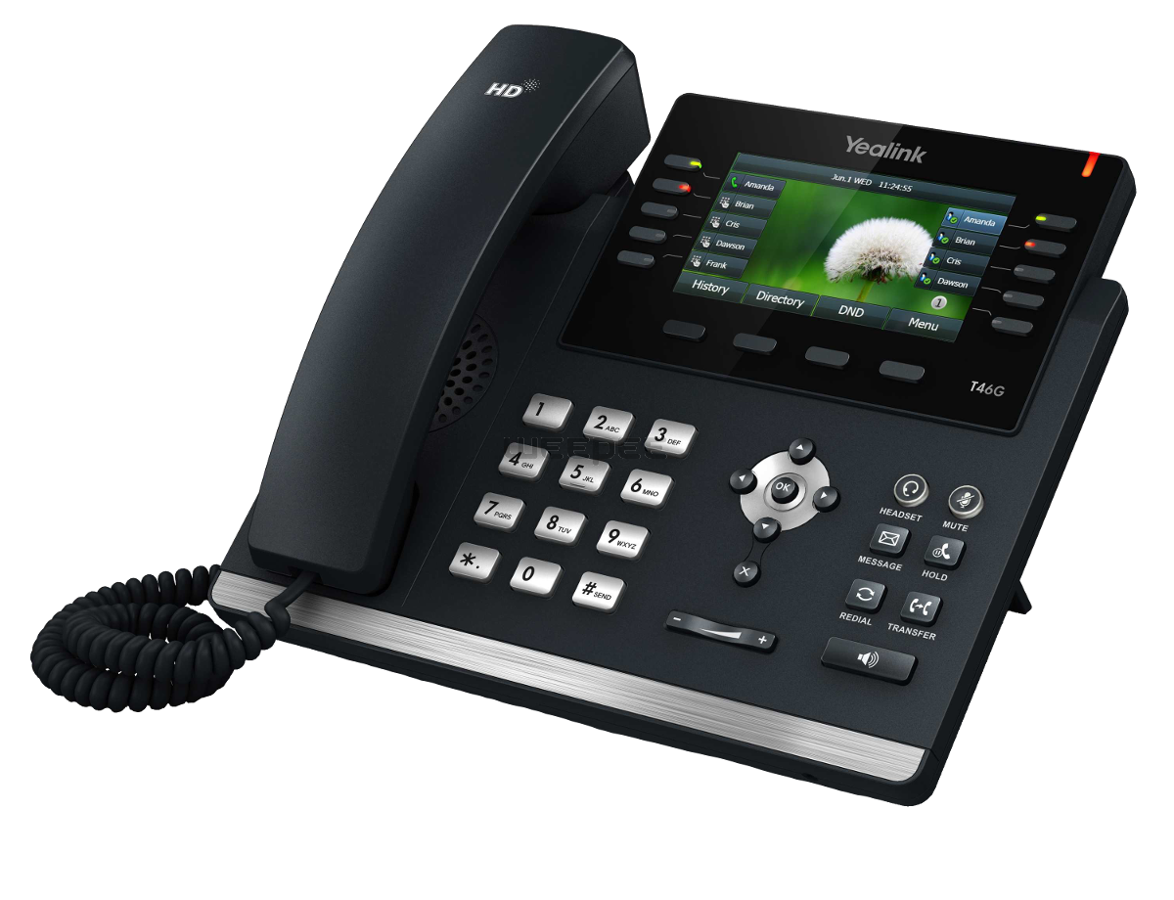
JMS VoIP Telephone Co
Reliable, Dependable, quality

Slide 2
About JMS VOIP Telephone Co
We are National Telecommunications & Technology Company
Been in business for 2 years
We specialize in VOIP, Web & Traditional Fax, SIP Trunks, SD Wan, Phone Systems, Low Voltage Wiring and Technology. Voice, Data, Audio, Video and Security & Camera Systems.

Slide 3
What is VoIP and Why?
Telephone calls and conversations over the Internet
VoIP is replacing all traditional analog and digital telephone lines
VoIP has been around since 1995
VoIP is reliable and saves money
VoIP allows your business to grow and expand easily
No more physical phone systems and expensive support contracts
Keeps working when your power and Internet are out
Adding new employees / users is quick and painless
Changes to your service can be done from anywhere with Internet
Compatible with your smart phone. Best of both worlds
Amazing features - allows the look and feel of any fortune 500 company
It just makes sense and your competition has probably already switched!

Slide 4
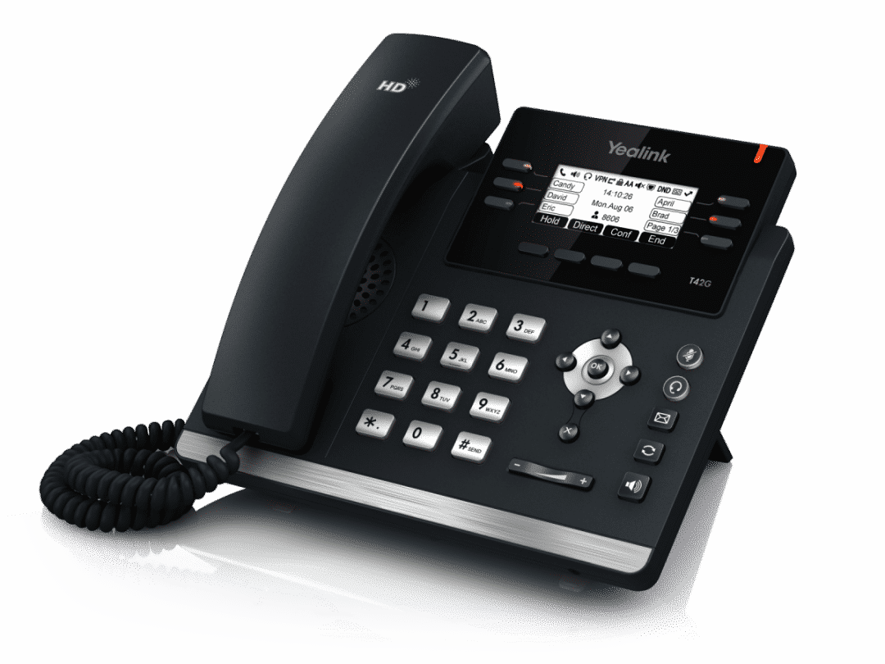
What does VoIP look like as our customer?
Our Hosted VoIP Platform
(On the Internet)
Internet
Traditional Telephone,
Cellular or VoIP provider
Standard or
VoIP phone
Smart Phone
Your Company
The Caller to your Company

Slide 5
Why Choose JMS VOIP Telephone Co
We provide reliable service. We do not cut corners
We’re local. You have a real person to contact
You’re not a number. No searching for who to call with support and long wait times
We’re a small business. We understand what you need and expect
Our Hosted VoIP platform has been in service since 2005
Our Hosted VoIP platform was designed and built internally. No open source
Our Hosted VoIP platform data centers are located in Maryland and Colorado
Our data centers are redundant and high availability with real time replication
The platform is safe, secure and protected from DoS/DDoS and Toll Fraud
The platform supports thousands of customers and phones from east to west coast

Slide 6
Not all VoIP Providers are the same!
Large Telephone companies make it hard to get support. You’re locked into website forms, they hide their direct phone numbers and when you call, its automated and difficult.
Most VoIP Providers today are using open source software solutions for their platform. The world knows that software code, both its strengths and weaknesses. Prone to downtime and feature outages. It’s costly to protect and is therefore often ignored in startups.
If the price of VoIP service is very low and too good to be true, it usually is. Many startup providers cut corners e.g. Security, DoS/DDOS protection, Toll Fraud protection and quality voice routes to offer a low price. This means more downtime for you and your customers, quality issues and image problems for your company and brand.
Many online VoIP providers offer initial deceptive pricing. When you sign up, they start adding in hidden costs. Many require you to pay a year or more in advance.
Many VoIP providers add additional features which most small and medium businesses never use, but still pay premium prices for.

Slide 7
Our Hosted PBX Telephone features
Free Intra-Domain Calls
Extension Calling
Ring/Hunt Groups
Conference Rooms
Paging Rooms
Auto Attendants
IVR Nodes
ACD/Agent Call Queues
Dial by Name Directory
Voicemail (Visual/Email)
Voicemail Escape
Voicemail to Email
Missed Call to Email
Direct Voicemail Xfer
Shared Mailboxes
3 Way Calling
Call Forwarding
Speed Dial
Find Me/Follow Me
Call Forwarding - Lost Registration
Call Transfer
Call Hold
Call Return
Call Waiting
Call Wakeup
Call Block
Park Calls
DND (Do Not Disturb)
Virtual Switchboard (Auto Attendant)
Virtual Extensions
Hot Desking
Barge/Listen/Teach
Shared Call Appearance (via phone)
Time Based Routing
Extension Monitor (BLF)
Wireless phone Support
Call Recording (per extension)*
Caller ID (Mapping/Anonymous)
Caller ID Name*
E911 Service
Music on Hold (MOH)
Custom Greetings
Time Zone Assignments
Single Extension/Multiple Devices
Company/Extension Address Books
CDR Records
Export CDR Records
Online Administration/Web Portal
System Alerts and Warnings
Local Numbers
Toll Free Numbers
Port Your Number
Softphone Support
Fax to Email/Send Fax*

Slide 8
Pricing for JMS VOIP
Standard SIP Trunk
Unlimited SIP Trunk
Additional Phone Shared Extension
Flat Rate Extension
$ 12.95
$ 21.95
$ 10.00
$ 24.95
per call path, per month
per call path, per month
Inbound and Outbound call rates apply
Registered or IP Authentication
Inbound and Outbound call rates to USA and Canada are included*
Registered or IP Authentication
per extension, per month
per extension, per month
Inbound and Outbound call rates apply
Internal calls and all standard PBX features are included and free
Inbound and Outbound call rates to USA and Canada are included*
Internal calls and all standard PBX features are included and free
Call Recording
WebFax
$ 10.95
$ 8.95
* Flat Rate and Shared Extensions include voicemail, voicemail to email, call forwarding, caller ID, E911 registration and disaster failover to external/cell number. *Toll Free inbound number rates apply for both standard and unlimited. International rates apply to both services. Excessive inbound and/or outbound traffic is subject to account review and fair use policy.
* Extensions have access to full standard PBX features: auto attendants, ring groups, ACD queues, shared voicemail, conference bridges, intercom, paging, night service flags, call park and auto provisioning.
* IP authenticated SIP Trunks allow for outbound caller ID control from attached IP PBX or SIP device.
per extension, per month
per account, per month
Records inbound and outbound calls to the extension up to 90 days
Searchable and downloadable for permanent archive
Inbound and Outbound faxes within USA included for free.
Up to 500 pages
Inbound faxes to email address Outbound faxes through portal

Slide 9
Any Questions ?

Slide 10
Thank You!
JMS VOIP LLC
www.jmsvoip.com
Jason M Seel… Phone 505-445-0595

